Slide 1

Binary Cycle Plant
Significant Figures
LEAP 1501 - Group 04

Slide 2
Geothermal Industry
Industry seems to be under appreciated, unkown source of clean, renewable energy.
Binary cycle plant allows for cooler geothermal reservoirs to be used in comparison with other geothermal plants.
Reason for potential unpopular energy choice: High up-front cost
Notes:
The geothermal Industry is very under appreciated, widely unknown source of clean energy. Geothermal industry invested in this binary cycle, it’s more flexible where you can set up a binary cycle plant in comparison with others. I think one of the biggest reasons for geothermal energy not being popular, is because of the upfront cost. The average cost to install a geothermal system is $7,160.

Slide 3
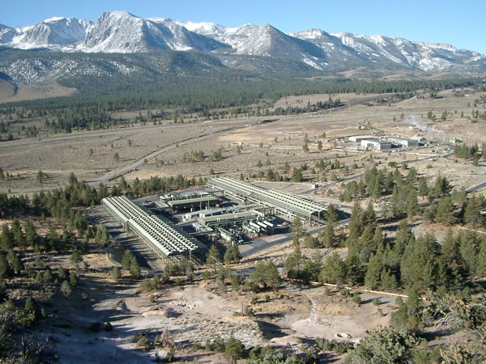
Mammoth Pacific Inc.
Located in the Sierra Nevada mountain range in
CA.
Award winning complex
Production of binary cycle plant, and
maintaining facilities
Sell electricity to Southern California Edison
and Pacific Gas & Electric
Notes:
Mammoth Pacific is located in the Sierra Nevada mountain range. This facility has won countless awards and they even offer tours of their facility. Mammoth Pacific was very much a part of producing binary plants, and maintaining the facilities where they’re located on the complex. They sell this energy off to help sustain the complex.

Slide 4
Geothermal Energy History
Discovery/Early Use
Native Americans, Asians,
Romans
Useage Today
United States Leads
Indonesia is 2nd Leader
Plant Developments
1904 Italy / 1922 United States
Future Usage
Today only 1% Used
Expected 10-20% by 2050
Notes:
Geothermal Energy usage begins with different people across the grove who used hot springs to cook, bathe, and heat things. First industrial usages were in Italy in the early 20th century. The first major industrial usages were in the United states starting in 1922 and advancing significantly from the 1960s to the 1980s. Today the United States is still the world leader in Geothermal energy production. That amount is still as low as 1% but is said to grow to 10-20 percent by 2050.

Slide 5
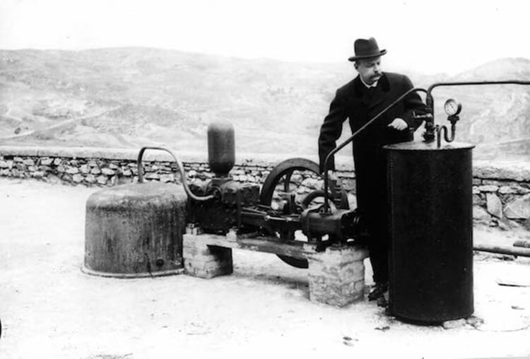
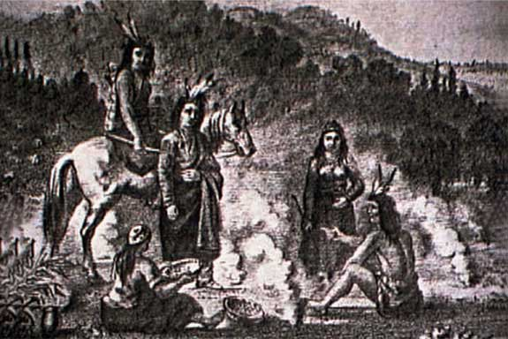
Geothermal Energy History
Prince Piero Ginori Conti, with his prototype generator that could provide enough wattage to light 4 light bulbs at a time.
Indigenous people utilizing Geothermal Energy.
Notes:
Piero Conti is remembered historically as the father of geothermal energy production. Indigenous people must receive credit as the first to use Geothermal energy in everyday life.

Slide 6
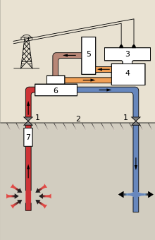
How the Technology Works
Pump drilled to natural hot water source
Hot water “flash vaporizes” a secondary fluid through heat exchanger
This binary fluid is what makes the binary cycle plant different from the two other types of geothermal plants
Pressurized steam turns turbines
Turbines generate electricity
Key: 1 Wellheads 2 Ground surface 3 Generator 4 Turbine 5 Condenser 6 Heat exchanger 7 Pump
Hot water
Cold water
Isobutane vapor
Isobutane liquid
Notes:
Here is a basic diagram of how a Binary Cycle plant works. The red is the hot natural water that is pumped into a heat exchanger that vaporizes the secondary fluid. A heat exchanger is a device that transfers heat between two fluids, and are separated by a wall to prevent mixing/contamination. This secondary fluid, or binary fluid is what sets the binary cycle plant apart from the others.
The secondary fluid (usually a butane) is evaporated and the steam is pressurized and goes through the orange into the steam turbines which generate electricity.

Slide 7
How the Technology Works
Steam exits turbine and is cooled back into fluid in the condenser
Fluid is cycled back through the heat exchanger
Meanwhile, natural cooled water returns to source
No gas emissions
Key: 1 Wellheads 2 Ground surface 3 Generator 4 Turbine 5 Condenser 6 Heat exchanger 7 Pump
Hot water
Cold water
Isobutane vapor
Isobutane liquid
Notes:
The steam comes out the other end of the turbine and goes into a condenser that cools the vapor back into liquid form and starts the process over by going back into the heat exchanger. While all that happens, the cooled water from the ground is channeled back to the source.

Slide 8
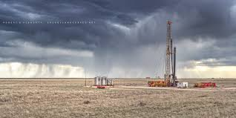
Manufacturing Process :
Drilling
Casing/Cementing
Construction
Notes:
The process of constructing a Binary plant varies depending on the location, however there is a general trend. To start, one has to find a suitable aquifer. To do so, predict where one might be, and drill into it. If it’s suitable, then the next step is to drill both an extraction and an insertion well. After that, the wells have to be supported with casing.Then comes installing all the machinery.

Slide 9
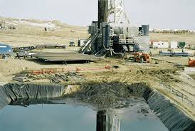

Problems With Construction
Monetary cost
Drilling Impact
Notes:
There are a couple of issues relating to the construction of a binary plant. The first is the fact that to start any geothermal plant, a lot of money is required. This is due to all of the expenses sunk into drilling and other related processes (no pun intended). The second problem is the actual environmental impact of drilling. Drilling produces a lot of waste in the form of drill pieces and drilling fluid which must be disposed of in a specific way.

Slide 10
Development of Geothermal Energy
Geothermal energy harnessed in the form of hot springs
- Gain in commercial value
Communities form around geothermal sources
Resources pipelined to homes and buildings (early 1900s)
- Use as main water source
- Heating systems
Notes:
Geothermal energy was initially recognized and became relevant during the time period when hot springs were first being used. The hot springs were discovered to have great commercial value. Hot water could be pipelined to homes to be used as a main water/heating system.

Slide 11
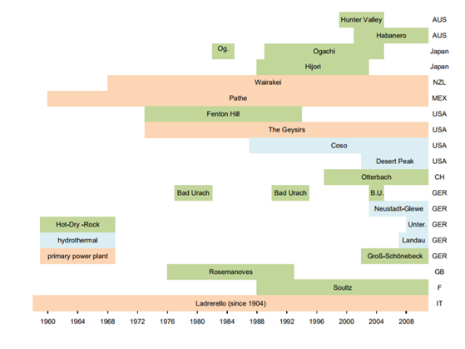
Development of Geothermal Energy
Geothermal plants being established for the first time in California (1960)
Italy, New Zealand and Mexico have recorded usage of geothermal energy prior to 1960s
- Hydrothermal oriented and steam-powered energy
Figure above shows the location and time period regarding where and when different forms of geothermal energy were commonly being used.
(https://www.geothermal-energy.org/pdf/IGAstandard/WGC/2010/0605.pdf)
Notes:
The first ever geothermal plants were established in California. Many other countries had discovered the value of geothermal energy long before America. Hydrothermal and steam-powered energy were the first forms.

